Slide 1

Job augmentation
Gayathri Adhimoolam

Slide 2
Road map
Introduction
Approach
Business understanding
Software used
Data analysis
Data preprocessing
Modelling
Evaluation
Conclusion and Future works

Slide 3
Introduction
PROBLEM STATEMENT:
To build an application that helps to restore the seniority levels for a given job decription and title.
APPROACH:
To build a supervised text classification model that is trained using the given data and to use the model to predict the seniority levels for the required data.

Slide 4
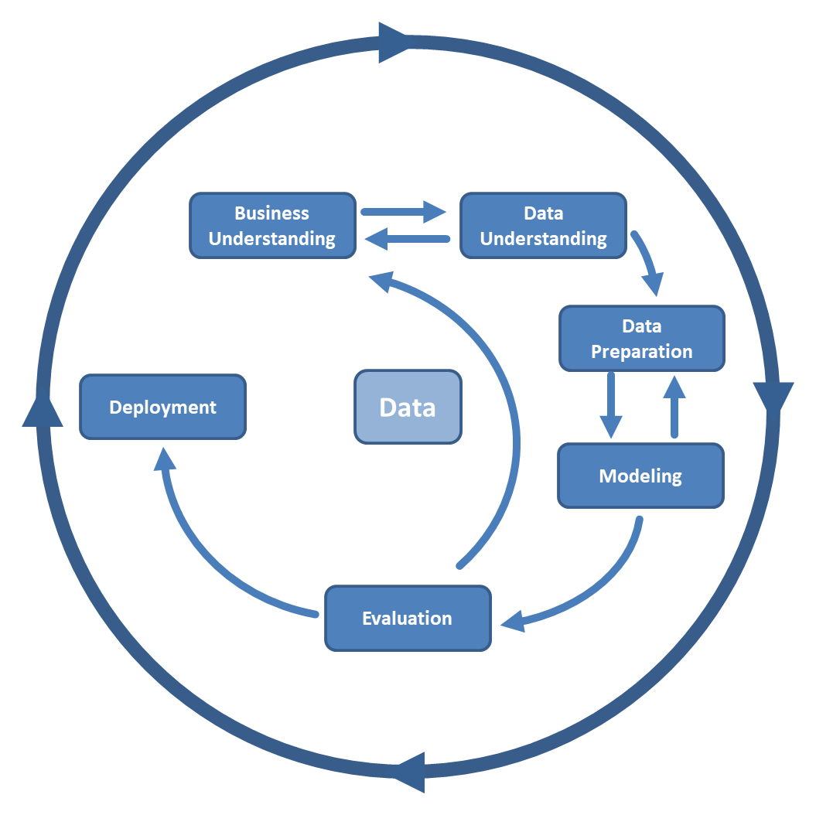
Approach
For this project, the CRISP-DM methodology is chosen as the overall approach to deal with the project.
CRISP-DM (short for cross-industry standard process for data mining) is a process model that can be employed to structure the analysis of data in different fields.
The process consists of six major phases and each phase is explained in the next slides.

Slide 5
Business Understanding
In this phase the overall goal, challenges and the context of a problem is understood.
The main goal of this project is to build a text classification model that will predict the seniority level of a job based on a given title and description.

Slide 6
Softwares used
PYTHON
Python offers great libraries for datascience and is opted because of the ease of use and the simple syntax.
SPARK-NLP
In earlier times, the performance of Natural Language Processing (NLP) was only suitable for hundreds or thousands of documents.
Due to the data deluge in recent years, it is vital to incorporate a suitable working approach.
Due to the inconsistency in text data, parallelizing and distributing has become more important but also more complex.
Apache Spark, a distributed framework, has introduced Spark-NLP that helps to overcome these challenges. In Spark-based programs, the processing is quicker since data is stored in memory.

Slide 7
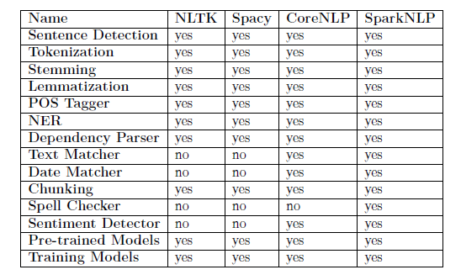
Comparison of NLP libraries
From the table, it is evident that the Spark-NLP has more features and models compared to the other libraries.
In a recent survey by O’Reilly, Spark-NLP is growing to be one of the most used libraries in recent times.
Since the model is built as an extension of the Spark ML API, the library can run models on a cluster, other machines or save them for later.
Also, the performance of the library is significant on both individual and cluster machines.
Spark-NLP trains eighty times faster than SpaCy in a comparison study conducted by O’Reilly for training a simple pipeline (sentence detection, tokenization, and part of speech tagging) on a single Intel i5, 4-core, and 16 GB memory machine.

Slide 8
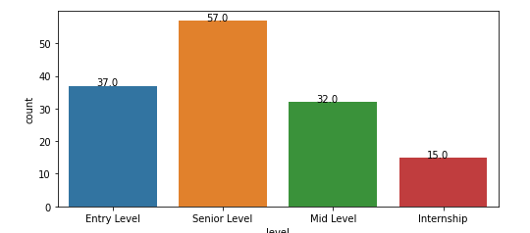
Data Understanding
As the business objective has been understood, the next step is to understand the data.
The given data has three columns:
Title : The title of the job
Description: The description gives a better understanding of the job. For example: the requirements, the company description
Level: This is the seniority level of each job. This would be the label for the classification problem.
The total number of entries in the data frame is 216, out of which the training set (with levels) is 141 and the test set (for which the levels has to be filled) is 75.
There are no null values, but 4 jobs (2 in training and 2 in test) have no job description.
The bar graph shows the number of entries based on the seniority levels. This shows that the dataset is imbalanced.

Slide 9
Data Preprocessing
In the this phase, the following preprocessing steps are done to the data set.
Remove \n
Replace numbers with words. E.g.: "3 years" as "three years"
Remove all the special characters.
Convert the text to lowercase.
Remove "description" or "job description" or "Job Purpose" or "No description available“.
Replace the abbreviations E.g.: sr., jr.
Remove the trailing white spaces at the beginning and end of the sentence.
Remove the single characters if available, for example: m f from (m/f).
Remove stop words.
Check for spelling mistakes and replace them with the right words.

Slide 10
Data Preprocessing
Remove non-English sentences:
In this project since the entries with non-English titles or descriptions are dropped. But, a spark-NLP pipeline which converts the sentences in other languages to English is also implemented for future use in a separate notebook.
Feature Engineering:
A new feature, named “text”, which combines both the title and the description column is created.
Data Imbalancement and Augmentation:
To achieve balance in the data, data is augmented using the nlpaug library. In a given sentence, words with similar meanings(synonyms) are replaced and so new data is created for the minority classes.

Slide 11
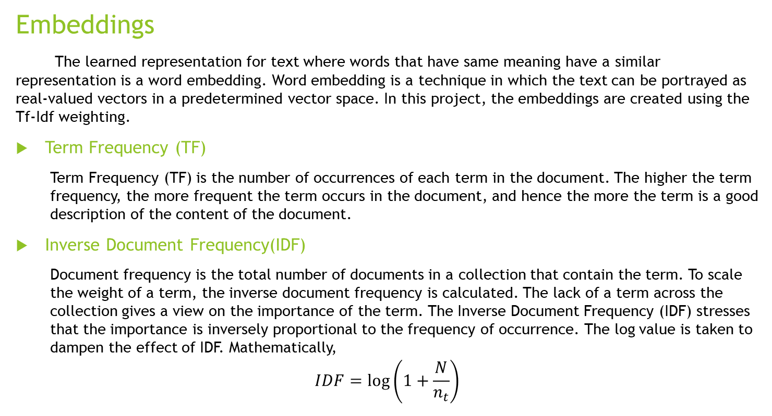
Modelling
Embeddings
The learned representation for text where words that have same meaning have a similar representation is a word embedding. Word embedding is a technique in which the text can be portrayed as real-valued vectors in a predetermined vector space. In this project, the embeddings are created using the Tf-Idf weighting.
Term Frequency (TF)
Term Frequency (TF) is the number of occurrences of each term in the document. The higher the term frequency, the more frequent the term occurs in the document, and hence the more the term is a good description of the content of the document.
Inverse Document Frequency(IDF)
Document frequency is the total number of documents in a collection that contain the term. To scale the weight of a term, the inverse document frequency is calculated. The lack of a term across the collection gives a view on the importance of the term. The Inverse Document Frequency (IDF) stresses that the importance is inversely proportional to the frequency of occurrence. The log value is taken to dampen the effect of IDF. Mathematically,
$$IDF=\log\left(1+\frac{N}{n_{t}}\right)$$

Slide 12
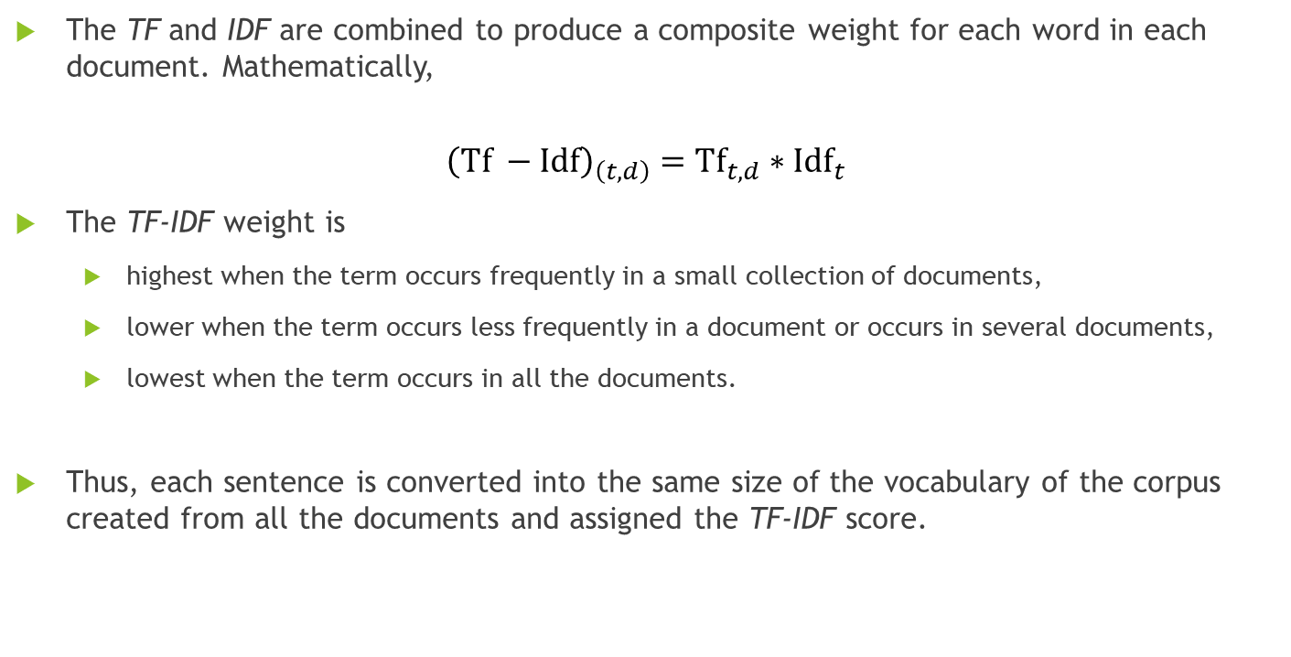
Modelling
The TF and IDF are combined to produce a composite weight for each word in each document. Mathematically,
$${\left(Tf −Idf\right)}_{\left(t,d\right)}={Tf}_{t,d}∗{Idf}_{t}$$
The TF-IDF weight is
highest when the term occurs frequently in a small collection of documents,
lower when the term occurs less frequently in a document or occurs in several documents,
lowest when the term occurs in all the documents.
Thus, each sentence is converted into the same size of the vocabulary of the corpus created from all the documents and assigned the TF-IDF score.

Slide 13
Modelling Spark-NLP pipeline
In order to get the embeddings the following pipeline is implemented using the spark-NLP and pyspark ML libraries.
Document Assembler
Tokenizer
Spell Checker
Normalizer
Stop words cleaner
Lemmatizer
Finisher
Hashing TF
Idf

Slide 14
Modelling Classifier models
The embeddings are used as inputs to classify the job levels. Three machine learning classifier models are chosen for the classification task. They are,
Decision trees
Random Forests
Logistic Regression
The classifiers are used to classify with different set of embeddings:
Embeddings from „title“ only
Embeddings from „description“ only
Embeddings from „text“ which is a combination of title and description
Embeddings from the „augmented text“.

Slide 15

Decision trees
Decision tree is a supervised learning technique widely used in classification problems.
Decision trees are typically drawn upside down, in the sense that the leaves are at the bottom of the tree.
The features of a dataset are represented by the internal nodes, the branches represent the decision rules ad each leaf node represents the outcome.
A decision tree simply asks a question, and based on the answer (Yes/No), it further split the tree into subtrees.
The best attribute to split a node is calculated by one of the attribute selection measures:
Entropy: The measurement of the impurity or randomness in the data points.
Gini Index: calculates the amount of probability of a specific feature that is classified incorrectly when selected randomly.

Slide 16
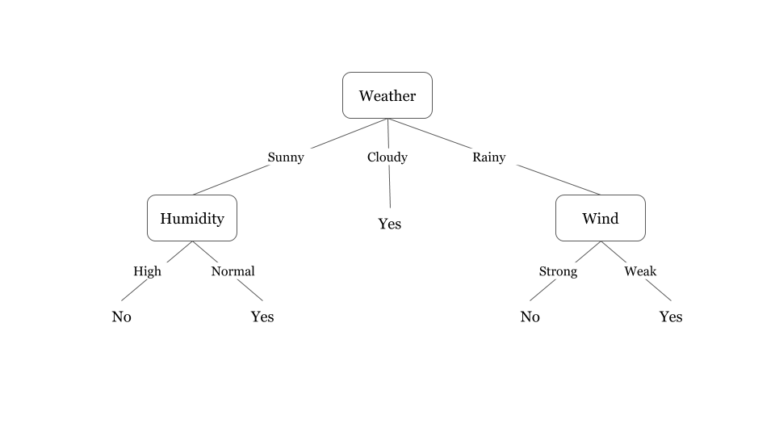
Decision trees
Since a large tree increases the risk of overfitting, and a small tree may not capture all the information from the features, decision trees uses a technique called pruning, that decreases the size of the tree without compromising the accuracy.
Decision Trees usually mimic human thinking ability while making a decision, so it is easy to understand.
The logic behind the decision tree can be easily understood because it shows a tree-like structure.
The disadvantage of decision tree is the overfitting issue, which can be resolved using the random forest algorithm.

Slide 17
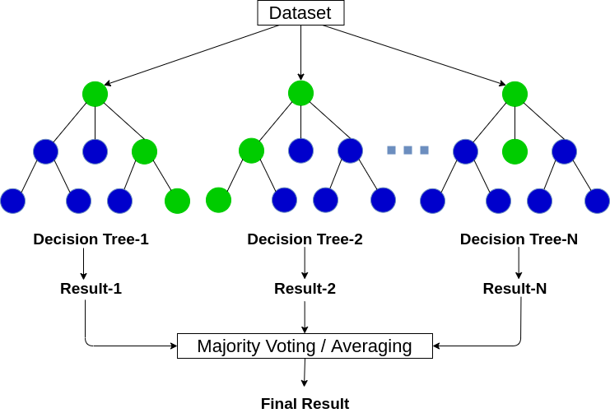
Random Forests
Random forest is an ensemble technique that consists of a large number of individual decision trees.
Each individual tree makes its prediction and the class with the most votes becomes the forest‘s prediction.
Random forests uses a technique called Bagging (Bootstrap Aggregation), which allows each tree to randomly sample from the dataset with replacement, resulting in different trees.
Unlike decision trees, each tree in a random forest can pick only from the random subset of features when splitting a node. This gives a more variation amongst the trees in the model.
A disadvantage is that due to the number of trees, it is computationally expensive and can take a long time to train.

Slide 18
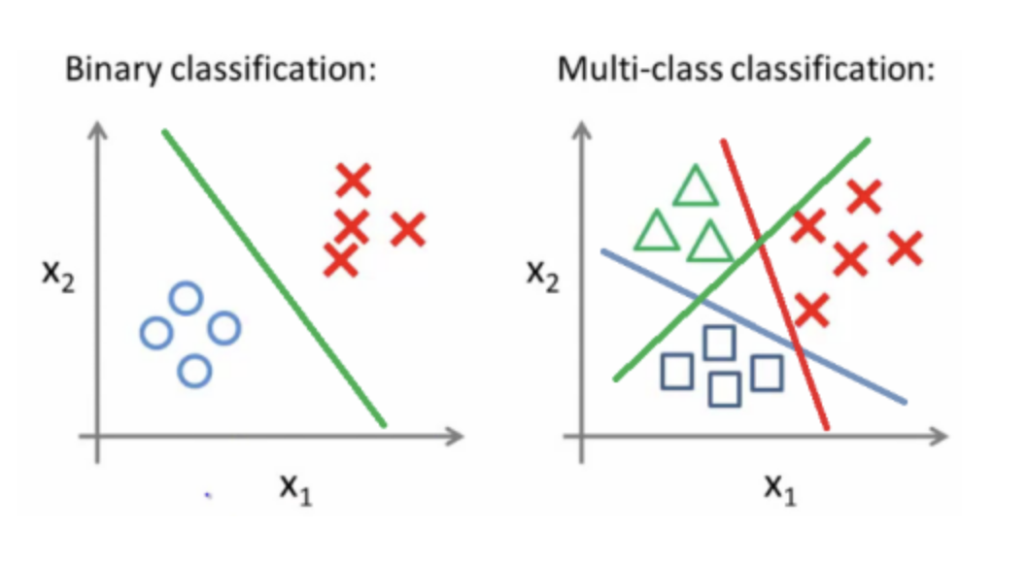
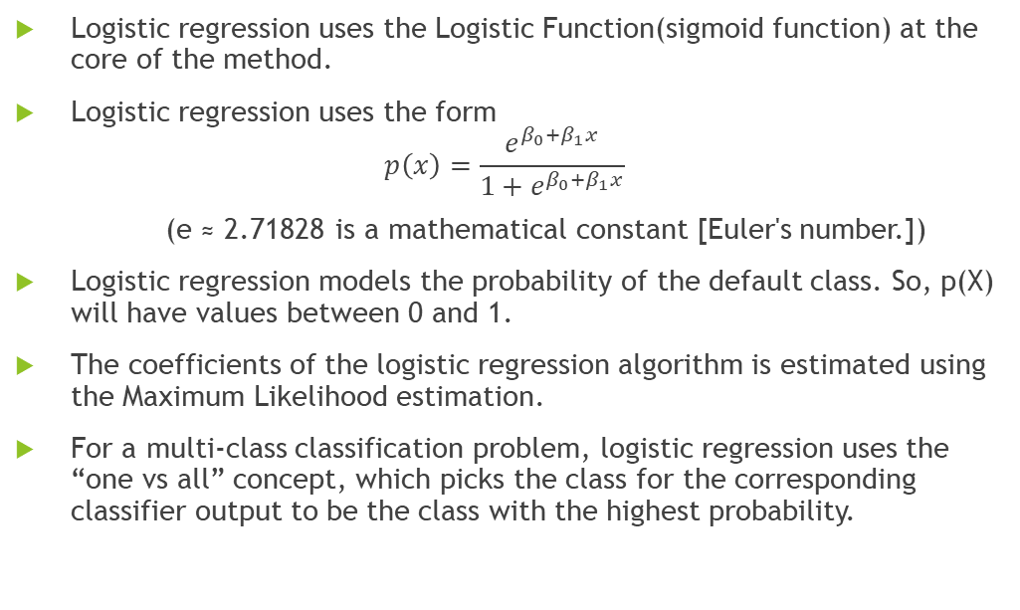
Logistic Regression
Logistic regression uses the Logistic Function(sigmoid function) at the core of the method.
Logistic regression uses the form
$$p\left(x\right)=\frac{ⅇ^{β_{0}+β_{1}x}}{1+ⅇ^{β_{0}+β_{1}x}}$$
(e ≈ 2.71828 is a mathematical constant [Euler's number.])
Logistic regression models the probability of the default class. So, p(X) will have values between 0 and 1.
The coefficients of the logistic regression algorithm is estimated using the Maximum Likelihood estimation.
For a multi-class classification problem, logistic regression uses the “one vs all” concept, which picks the class for the corresponding classifier output to be the class with the highest probability.

Slide 19
Evaluation Confusion matrix
The best way to evaluate the performance of a classifier is by using the confusion matrix.
This matrix allows you to identify which points are correctly classified and which points are incorrectly classified.
The points in the grids with matching actual and predicted classes are the correct predictions and these points should be maximised for greater accuracy.
The green grids in the above image are the grids for the correctly classified points.
In an ideal scenario, all other grids should have zero points.

Slide 20
Evaluation Confusion matrix
In a multi-class confusion matrix:
False-negative value for a class will be the sum of values of corresponding rows except for the TP value.
False-positive value for a class will be the sum of values of the corresponding column except for the TP value.
True Negative value for a class will be the sum of values of all columns and rows except the values of that class that we are calculating the values for.
True positive value is where the actual value and predicted value are the same.

Slide 21
Evaluation metrics
Accuracy: It gives the overall accuracy of the model, meaning the fraction of the total samples that were correctly classified by the classifier.
Accuracy = (TP+TN)/(TP+TN+FP+FN).
Precision: It tells what fraction of predictions as a positive class were actually positive.
Precision = TP/(TP+FP).
Recall: It tells what fraction of all positive samples were correctly predicted as positive by the classifier. It is also known as True Positive Rate (TPR), Sensitivity, Probability of Detection
Recall = TP/(TP+FN).
F1-score: It combines precision and recall into a single measure. Mathematically it’s the harmonic mean of precision and recall.

Slide 22
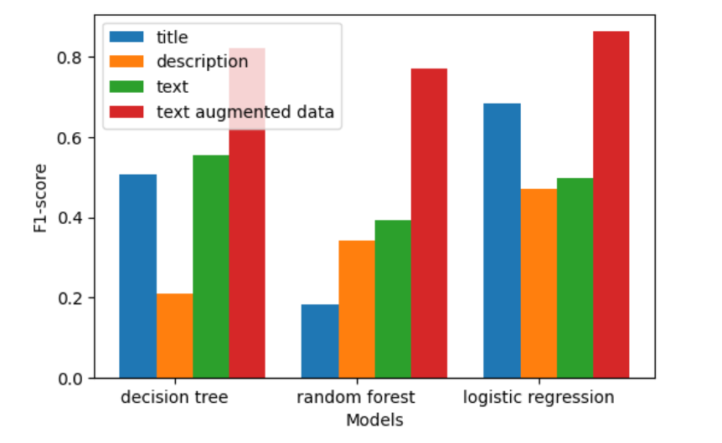
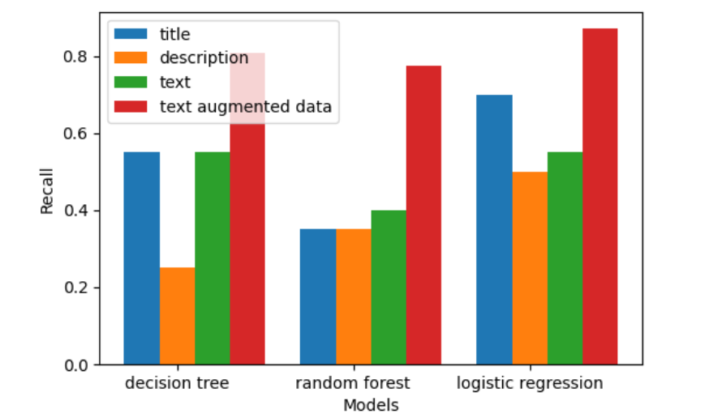
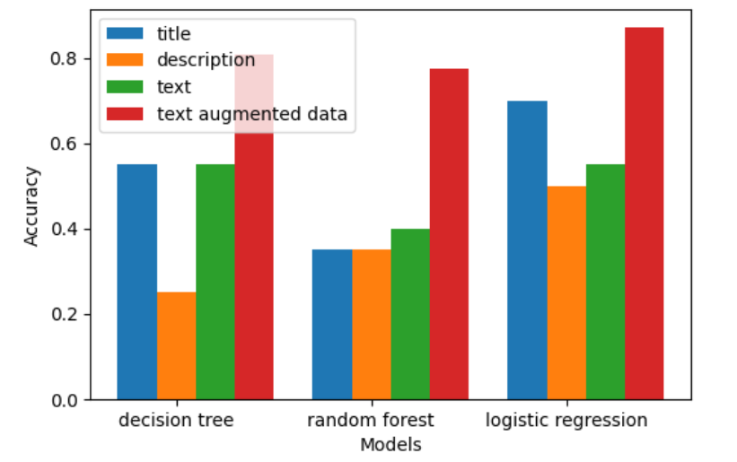
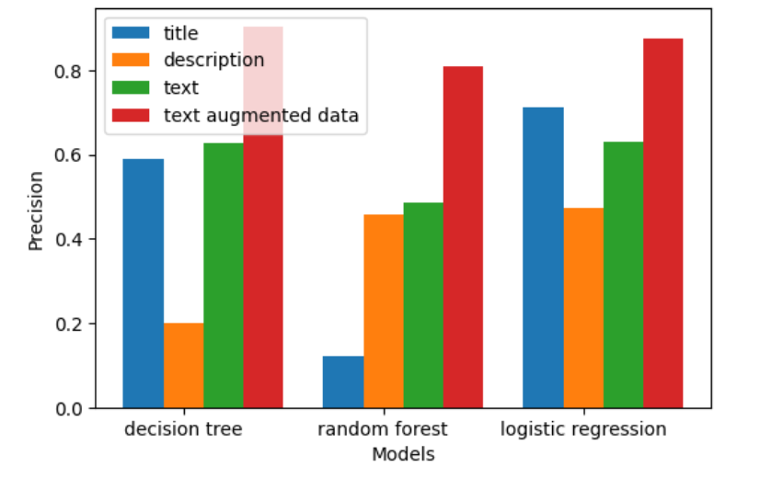
Evaluation of metrics on different datasets
From the bar graphs shown, the following observations are made:
All the models perform better with the augmented data set in terms of all the metrics.
Logistic regression performs better than the other models in terms of accuracy and f1-score.

Slide 23
Hyper parameter tuning
Since the logistic regression model performs better than the decision tree and random forest classifier, it is chosen to be the best classifier so far.
In order to verify if an improvement in performance can be achieved, cross validation is used to tune the hyper parameters of the model.
Cross validation
Cross-validation is a resampling procedure used to evaluate machine learning models on a limited data sample.
The procedure has a single parameter called k that refers to the number of groups that a given data sample is to be split into. As such, the procedure is often called k-fold cross-validation.
Cross-validation is primarily used in applied machine learning to estimate the skill of a machine learning model on unseen data. That is, to use a limited sample in order to estimate how the model is expected to perform in general when used to make predictions on data not used during the training of the model.
It is a popular method because it is simple to understand and because it generally results in a less biased or less optimistic estimate of the model.

Slide 24
Cross validation
The following hyper parameters are chosen for cross-validation of the logistic regression with 4-fold:
elasticNetParam - the elastic net is a regularized regression method that linearly combines the L1 and L2 penalties of the lasso and ridge methods.
regparam - regularisation parameter.
maxIter - maximum number of iterations
The final metrics achieved are:
Accuracy = 0.83871
Precision = 0.890323
Recall = 0.83871
F1_score = 0.829032

Slide 25
Conclusion
From the evaluation, it is evident that the augmentation improved the model performance by more than 36%. Hence, it is proof that more data can improve the classification in a better way.
Among the models, logistic regression achieved the maximum performance.
From the cross validation, it is clear that the logistic regression model with the default parameter values performs better.
The seniority levels for the missing jobs are filled and stored as a csv file.

Slide 26
Future works
Model Explainability is a broad concept of analysing and understanding the results provided by ML models and to understand how the model arrives at a specific decision.
There are different ways to achieve this. A simple approach would be to use the coefficients of the logistic regression to understand the importance of each word. There are other libraries like SHAP(Shapley Additive exPlanations) that are specifically programmed to achieve explainability.
Advanced methods such as BERT, Glove could be used to generate embeddings.
Finally, complex models that uses deep learning techniques can be implemented.

Slide 27


